Slide 1
Discrete Mathematics
South China University of Technology

Slide 2
Chapter 1. Logic and Proof, Sets, and Function
Nested Quantifiers
Section 1.4

Slide 3
Contents
1
Translating Statements Involving Nested Quantifiers
2
Translating Statements Into Logical Expressions
3
Negating Nested Quantifiers
4
The Order of Quantifiers

Slide 4
Translating Statements Involving Nested Quantifiers

Slide 5
Example 1
∀x ∀y (x + y = y + x)
says that x + y = y + x for all real number x and y.
∀x ∃y (x + y = 0)
says that for every real number x there is real number y such that x + y = 0.

Slide 6
Example 2
∀x ∀y ((x >0) ∧ (y <0) → (xy<0)):
The statement says that for every real number x and y, if x >0 and y <0, then xy<0.
“The product of a positive real number and a negative real number is negative real number.”

Slide 7
Example 3
∀x (C(x) ∨ ∃y (C(y) ∧ F(x, y))), where
C(x) is “x has a computer,”
F(x, y) is “x and y are friends”,
Domain: all students in your school.
Every student in your school has a computer or has a friend who has a computer.

Slide 8
Example 4
∃ x ∀y ∀z
((F(x, y) ∧ F(x, z) ∧ (y≠ z)) → ¬ F(y, z))
where F(a, b) means a and b are friends and the universe of discourse for x, y and z consists of all students in your school.
There is a student none of whose friends are also friends with each other.

Slide 9
Translating Statements Into Logical Expressions

Slide 10
Example 5
F(x) represents “x is female”
P(x) represents “x is a parent”
M(x, y) represents “x is the mother of y”
“If a person is female and is a parent, then this person is someone’s mother”
∀x ((F(x) ∧ P(x)) → ∃y M(x, y))
∀x ∃y ((F(x) ∧ P(x)) → M(x, y))

Slide 11
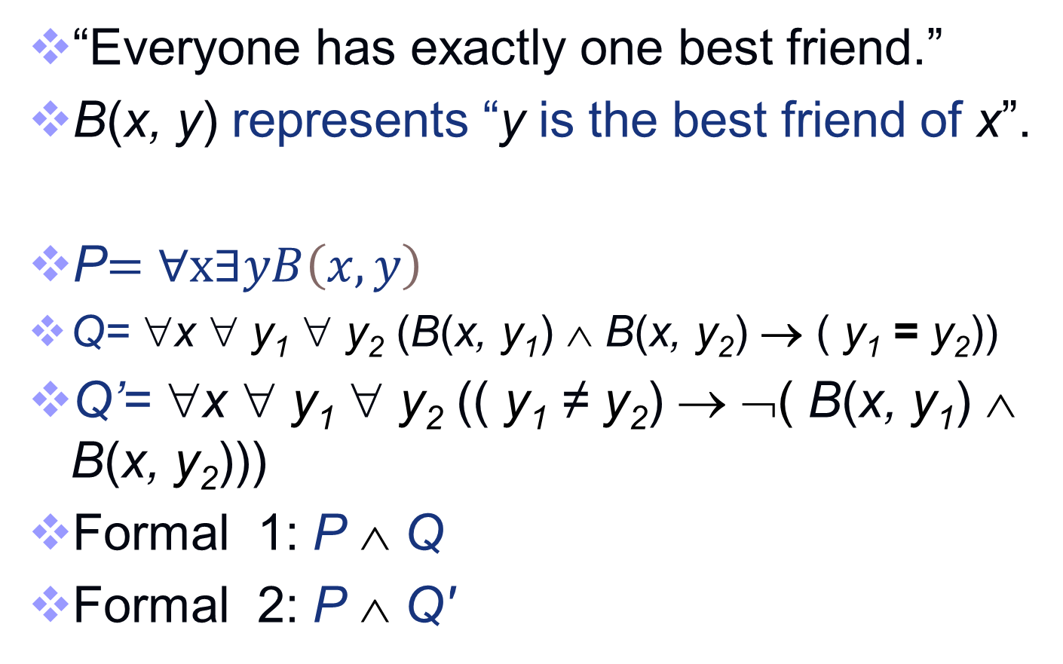
Example 6
“Everyone has exactly one best friend.”
B(x, y) represents “y is the best friend of x”.
P$=$ $∀x∃yB\left(x,y\right)$
Q= ∀x ∀ y₁ ∀ y₂ (B(x, y₁) ∧ B(x, y₂) → ( y₁ = y₂))
Q’= ∀x ∀ y₁ ∀ y₂ (( y₁ ≠ y₂) → ¬( B(x, y₁) ∧ B(x, y₂)))
Formal 1: P ∧ Q
Formal 2: P ∧ Q'

Slide 12
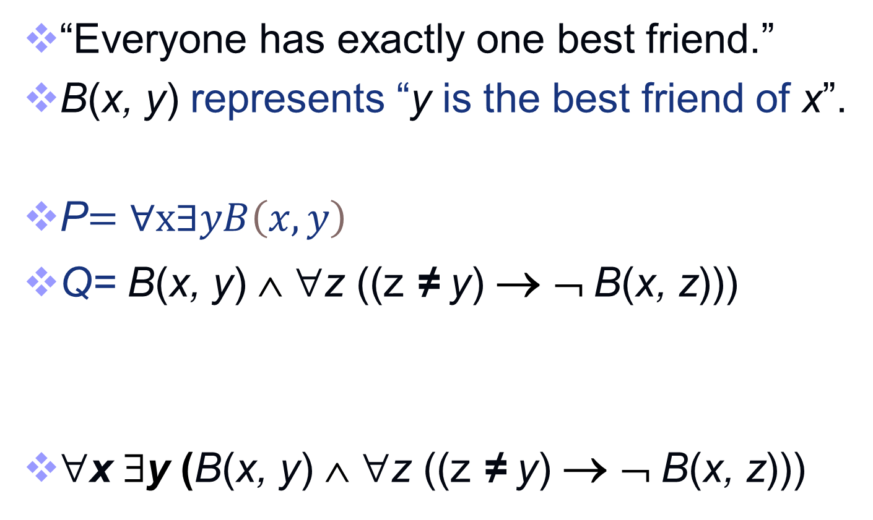
Example 6
“Everyone has exactly one best friend.”
B(x, y) represents “y is the best friend of x”.
P$=$ $∀x∃yB\left(x,y\right)$
Q= B(x, y) ∧ ∀z ((z ≠ y) → ¬ B(x, z)))
∀x ∃y (B(x, y) ∧ ∀z ((z ≠ y) → ¬ B(x, z)))

Slide 13
Example 7
“There is a woman who has taken a flight on every airline in the world.”
P(w, f) : passenger w has taken flight班机f
Q(f, a) : f is a flight班机 on airline航线 a
R(w, f, a): w has taken f on a
∃w ∀a ∃f (P(w, f) ∧ Q(f, a) )
∃w ∀a ∃f R(w, f, a)

Slide 14
Example 8-9
“The sum of two positive integers is positive.”
∀x ∀y ((x > 0) ∧ (y > 0) → (x + y >0 ))
“Every real number except zero has a multiplicative inverse.”
∀x ((x ≠ 0) → ∃y ( xy = 1 ))

Slide 15
Negating Nested Quantifiers

Slide 16
Example 11
¬ ∀x ∃y (xy = 1)
⇔ ∃x ¬ ∃y (xy = 1)
⇔ ∃x ∀y ¬ (xy = 1)
⇔ ∃x ∀y ( xy≠ 1 )

Slide 17
Example 12
What is the negation of the logic expression of Example 7.
∃w ∀a ∃f (P(w, f) ∧ Q(f, a) ) Example 7
¬ ∃w ∀a ∃f (P(w, f) ∧ Q(f, a) )
⇔ ∀w ¬ ∀a ∃f (P(w, f) ∧ Q(f, a) )
⇔ ∀w ∃ a ¬ ∃f (P(w, f) ∧ Q(f, a) )
⇔ ∀w ∃ a ∀ f ¬ (P(w, f) ∧ Q(f, a) )
⇔ ∀w ∃ a ∀ f ( ¬ P(w, f) ∨ ¬ Q(f, a) )

Slide 18
Example 10 and Example 13
Logic expression of the definition of a limit using quantifiers.
Limx→a f ( x ) = L
∀ε>0 ∃δ >0 ∀x >0 (0<|x–a|<δ → | f (x)–L|<ε)
Limx→a f ( x ) ≠ L
= ¬ [Limx→a f ( x ) = L]
= ¬∀ε>0 ∃δ >0 ∀x >0 (0<|x–a|<δ →|f (x)-L|<ε)
= ∃ε<0¬ …. ?????

Slide 19
∀ and ∃
Theorem 1(original version):
¬ [∀xP(x)] ⇔ ∃ x[¬ P(x)]
Theorem 2 (extended version):
¬ ∀x [x ∈D → P(x)] ⇔ ∃ x[x ∈D ∧ ¬ P(x)]
Theorem 2 (alternative version):
¬ ∀x ∈D[P(x)] ⇔ ∃ x ∈D [¬ P(x)]

Slide 20
∀ and ∃
Theorem 2 (alternative version):
¬ ∀x [x ∈D → P(x)] ⇔ ∃ x[x ∈D ∧ ¬ P(x)]
¬∀ε>0 ∃δ >0 ∀x >0 (0<|x–a|<δ →|f (x)-L|<ε)
= ∃ε>0¬ ∃δ >0 …..
= ∃ε>0 ∀ δ >0 ¬ …..

Slide 21
Example 10 and Example 13
Limx→a f ( x ) ≠ L
¬∀ε>0 ∃δ >0 ∀x >0 (0<|x–a|<δ →|f (x)-L|<ε)
⇔∃ε >0 ∀δ >0 ∃x >0 ¬(0<|x–a|<δ→|f (x)-L|<ε)
⇔∃ε >0 ∀δ >0 ∃x >0 ¬[¬ (0<|x–a|<δ) ∨ |f (x)-L|<ε]
⇔∃ε >0 ∀δ >0 ∃x >0 (0<|x–a|<δ ∧ ¬|f (x)-L|<ε)
⇔∃ε >0 ∀δ >0 ∃x >0 (0<|x–a|<δ ∧ |f (x)-L|≥ε)

Slide 22
The Order of Quantifiers

Slide 23
Quantifications of Two Variables
Let domain of x be {Turing, Yao}. Let domain of y be {Mathematics, Cryptography}. ∀x ∀y P(x,y) ? ∀y ∀x P(x,y) ?
∀x ∀y P(x,y)=P(T,M) ∧ P(T,C) ∧ P(Y, M) ∧ P(Y, C)
= ∀y ∀x P(x,y)
Theorem: ∀x ∀y P(x,y)= ∀y ∀x P(x,y)

Slide 24
Quantifications of Two Variables
Theorem: ∃x ∃y P(x,y) = ∃y ∃x P(x,y)
When Ture? There is a pair x, y for which P(x, y) is true.
When False? P(x,y) is false for every x,y.

Slide 25
Quantifications of Two Variables
∀x ∃y P(x,y) = ∃y ∀x P(x,y) ???
∃x ∀y P(x,y) = ∀y ∃x P(x,y) ???
Let domain of x, y be all people. P(x,y): y is father of x.

Slide 26
Quantifications of Two Variables
Theorem:
∀x ∃y P(x,y) != ∃y ∀x P(x,y)
∃x ∀y P(x,y) != ∀y ∃x P(x,y)

Slide 27
Example 16
Let Q(x,y,z) be the statement “x+y=z”
∀x ∀y ∃z Q(x,y,z)
“For all real numbers x and for all real numbers y there is a real number z such that x+y=z.” True
∃z ∀x ∀y Q(x,y,z)
There is a real number z such that for all real numbers x and y it is true that x+y=z False

Slide 28
Exercises
P57
6 c g, 7 d g k, 16 b d
28

Slide 29
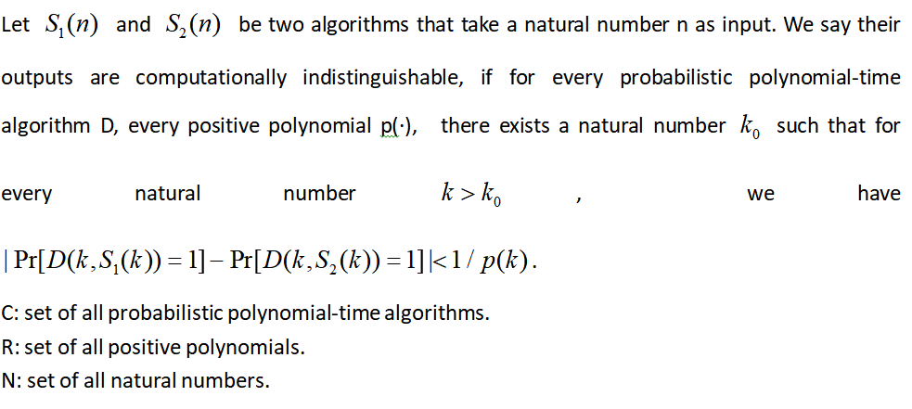

Slide 30
End of the Section 1.3
30

